Slide 1
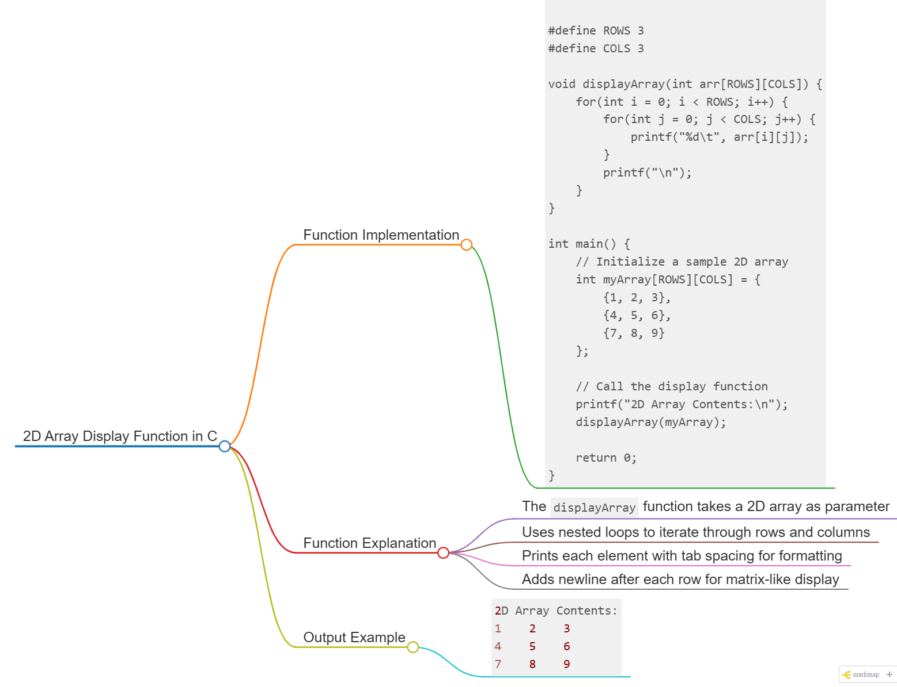
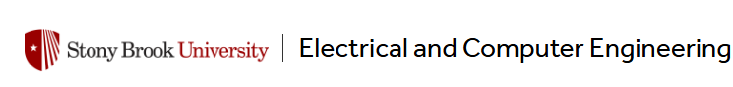
Mastering C Functions and 2D Arrays
In Week 9, Lab 7, we're exploring two fundamental aspects of C programming.
Enhance your skills with functions and 2D arrays.

Slide 2
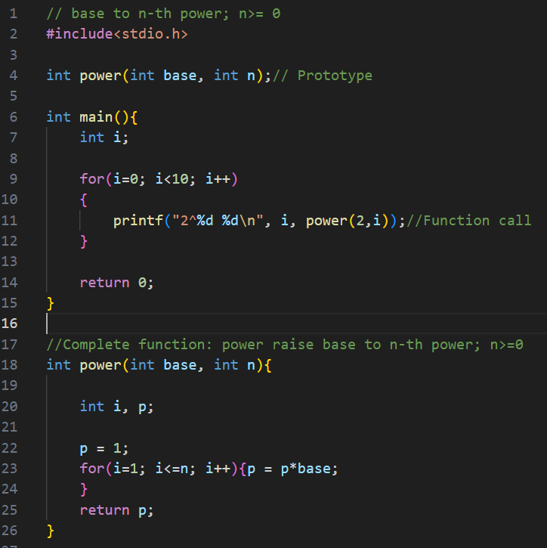
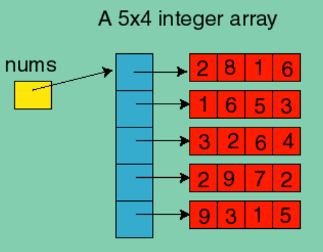
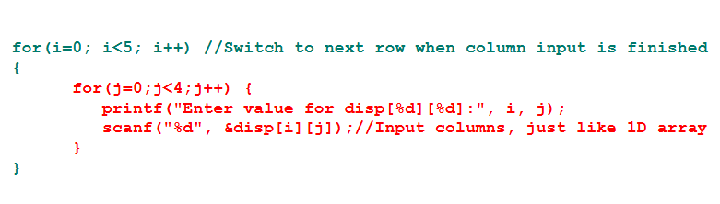
Today's Learning Objectives – Functions and 2D Array
Functions in C Programming
2D Arrays
Learn to create and use functions effectively
Master multi-dimensional data storage
Notes:
Today we'll be covering two key topics in C programming: functions and 2D arrays. First, we'll dive into functions - how to create, declare, and use them effectively in your C code. Functions are essential building blocks that allow you to modularize your programs and reuse common logic. Next, we'll explore 2D arrays - powerful data structures that enable multi-dimensional data storage and manipulation. 2D arrays are crucial for working with grid-based data, such as images or game boards. Throughout the session, we'll use a clean, modern IDE interface to demonstrate these concepts visually, with sample C code on the left and a 2D array visualization on the right. By the end of this presentation, you'll have a solid understanding of how to leverage functions and 2D arrays to write more robust, efficient, and maintainable C programs.

Slide 3
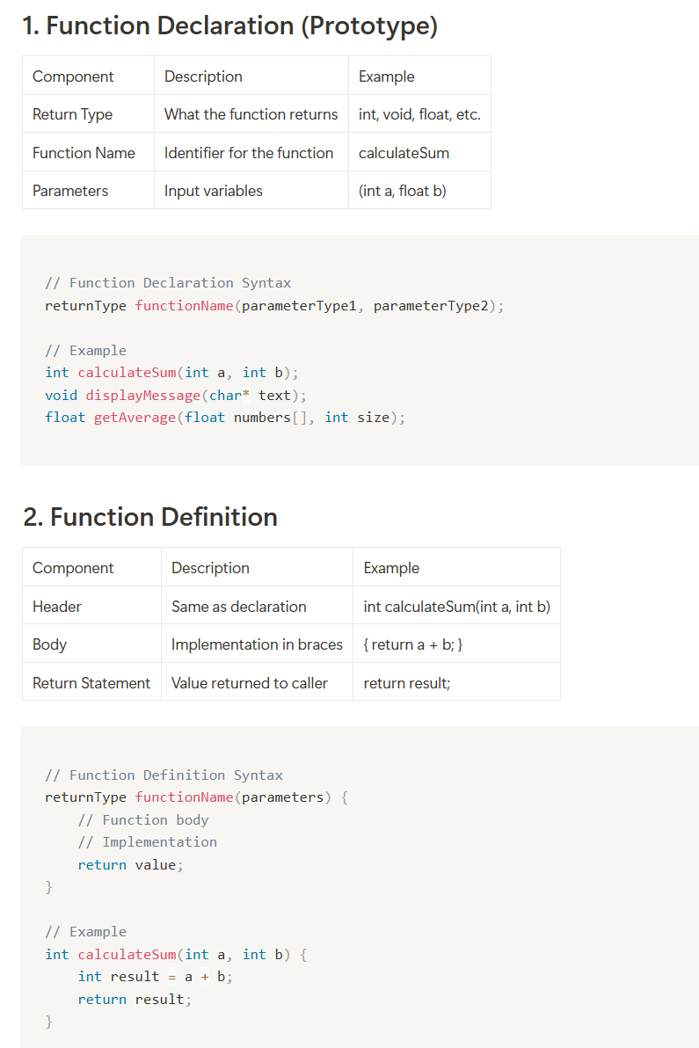
What is a Function?
Definition
A mini-program within your program that groups code to perform a specific task.
Functions enhance program organization and readability.
Components
Function name
Return type
Parameters (if any)
Function body { … }

Slide 4
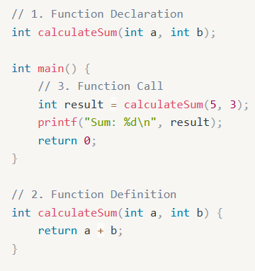
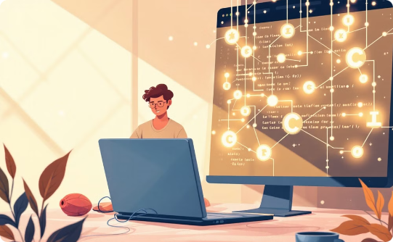
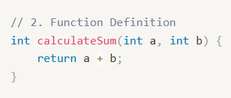
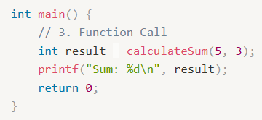
Understanding C Functions
Learn the Syntax
Build Reusable Code
Apply in Programs
Grasp function declaration and definition formats.
Craft modular solutions for recurring tasks.
Incorporate functions into extensive applications.

Slide 5
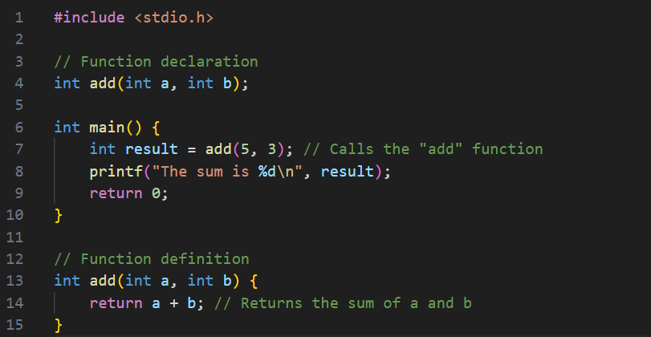
Function Implementation
Prototype Declaration
1
int add(int a, int b); // Needed when function defined after main
2
Main Function
Call the function: int result = add(5, 3);
Function Definition
3
int add(int a, int b) { return a + b; } // Actual implementation

Slide 6
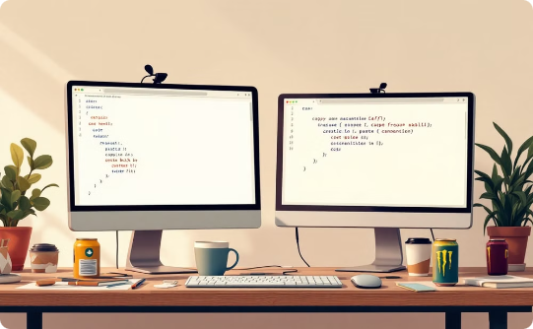
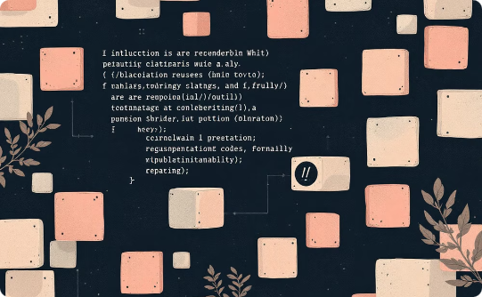
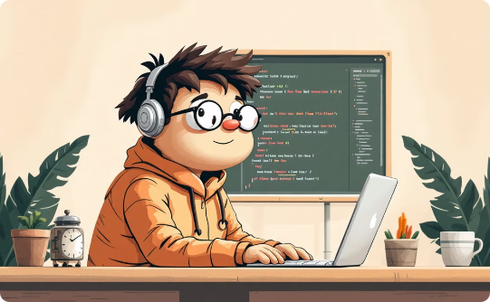
Benefits of Functions
Code Reusability
Modularity
Easier Debugging
Use functions multiple times to simplify maintenance.
Breaks down complex tasks into manageable pieces.
Isolate and fix problems easily within specific functions.

Slide 7
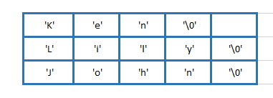
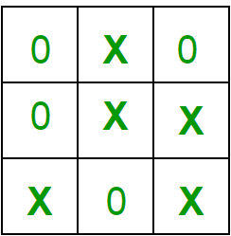
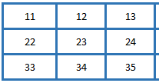
2D Array Examples
int main() {
// Method 1: Array of strings
char names[][5] = {"ken", "lily", "john"};
// Method 2: Array of character pointers
char *names2[] = {"ken", "lily", "john"};
// Print Method 1
printf("Method 1 output:\n");
for(int i = 0; i < 3; i++) {
printf("%s\n", names[i]);
}
// Print Method 2
printf("\nMethod 2 output:\n");
for(int i = 0; i < 3; i++) {
printf("%s\n", names2[i]);
}
return 0;
}
Basic syntax: int arr[rows][columns] int arr[3][3] = {{11, 12, 13}, {22, 23, 24}, {33, 34, 35};

Slide 8
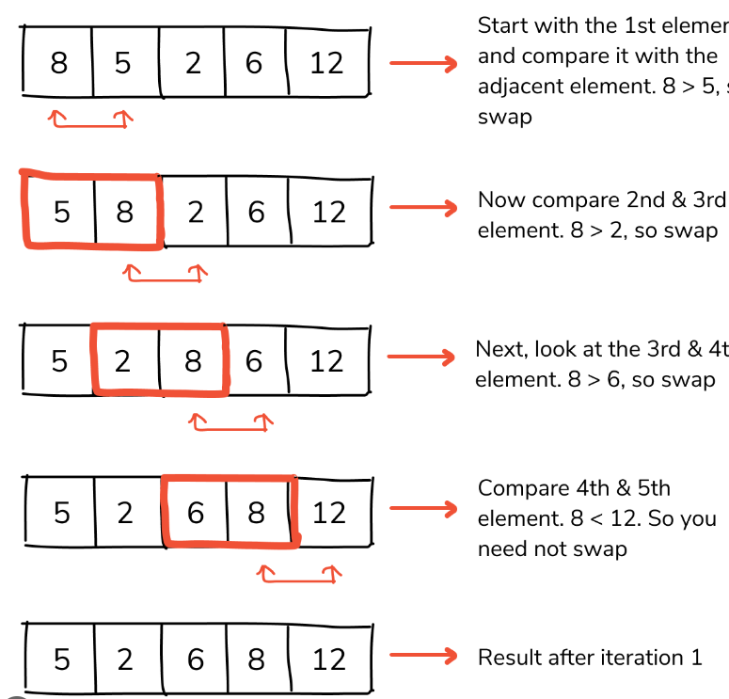
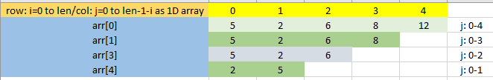
Review the bubble sort we have seen - 2D array
int arr[] = {8, 5, 2, 6, 12};
int len, i, j, tmp; // i is reading element from arr; j is writing sorted elements to arr
len = sizeof(arr)/sizeof(int);
printf("len = %d\n", len);
for (i=0; i<len; i++)
{
//second loop is find the max value on the 1D array
for(j=0; j<len-1-i; j++)
{
if(arr[j]>arr[j+1])
{
tmp = arr[j];
arr[j] = arr[j+1];
arr[j+1] = tmp;
}
}
}
for(j=0; j<len; j++)
printf("\n\narr[%d] = %d\n", j, arr[j]);

Slide 9
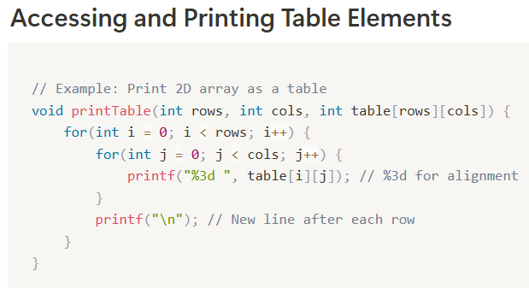
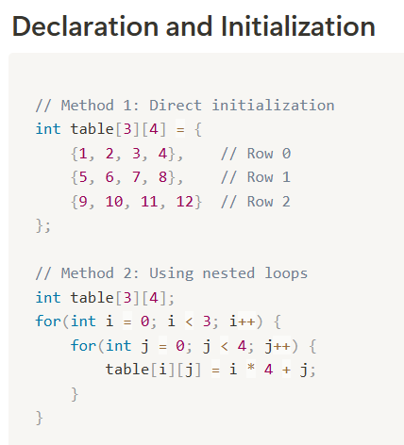
Summary:
Function - A function is a reusable block of code that performs a specific task: regarding function parameters and return values
2D Array - Treat as a table

Slide 10
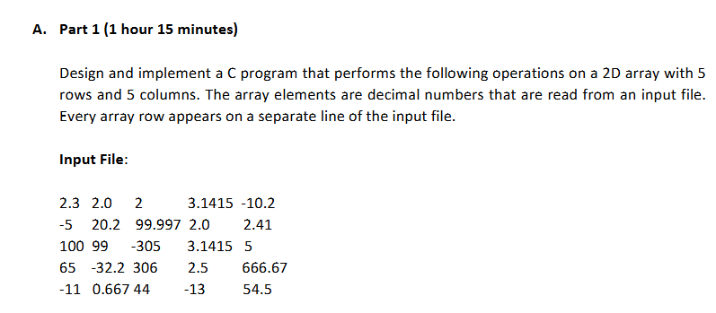
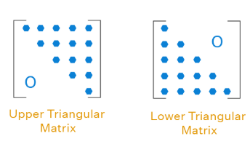
Lab 7 Exercise A
Part 1 - 1
Part 1 - 2
Part 1 - 3
The program finds the sum of three rows of the 2D array. The row numbers are read from the keyboard. The sum is displayed.
Input Sequence: 0 1 3 Output: 1126.818481
Displays the upper triangular part of the 2D arrays, and then compute the sum of its elements
Swaps rows m and n in the 2D array. The values of m and n are read from the keyboard.

Slide 11
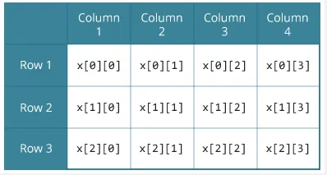
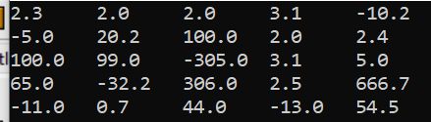
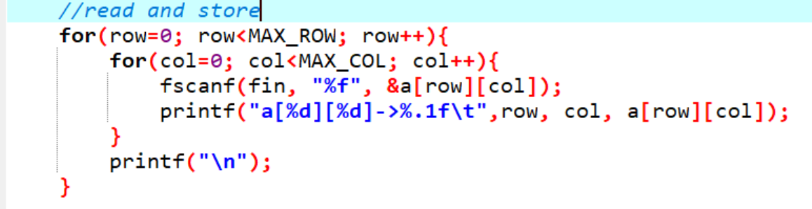
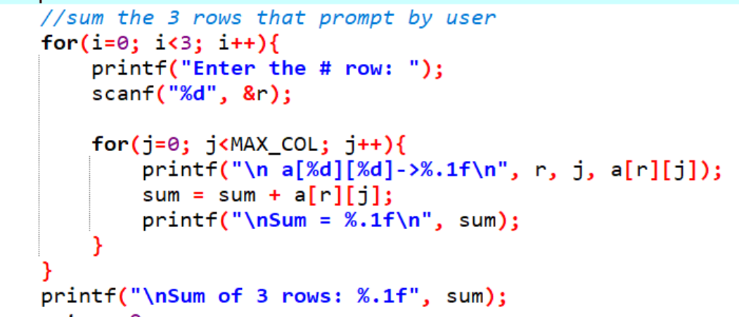
Exercise A
Part 1 - 1
for (0 to 2)
read row;
for (col from 0 to 4)
sum += a[row][col];
output sum;

Slide 12
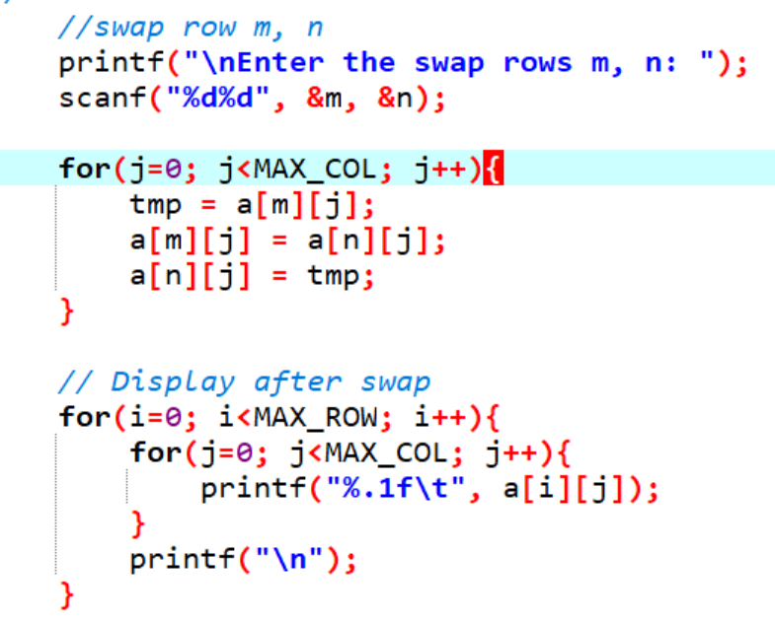
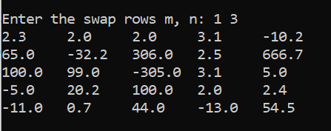
Part 1 – 3 Swap Row m, n
Part 1 – 3 Swap Row m, n

Slide 13
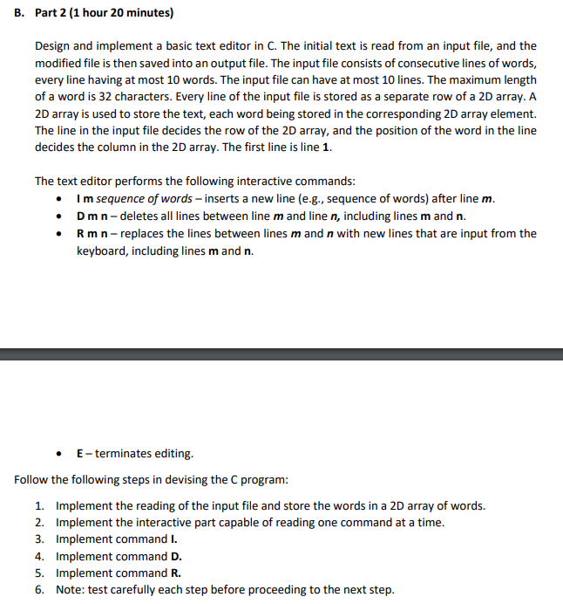
Lab 7 Exercise B

Slide 14
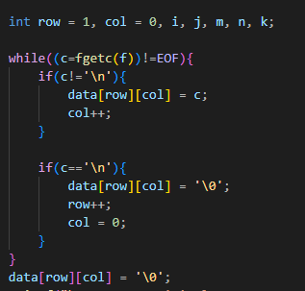
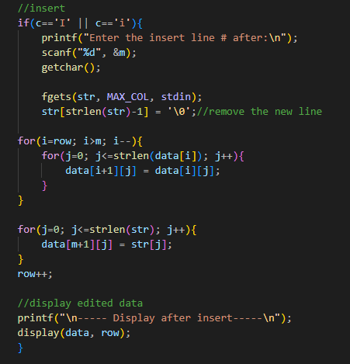
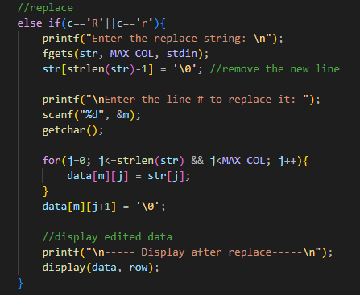
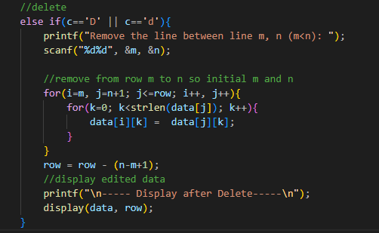
Lab 7 Exercise B
store/read data from file
Insert after m row
Replace row
Delete row

Slide 15
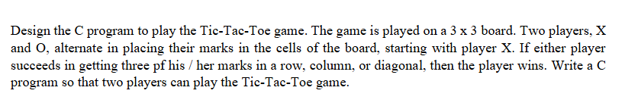
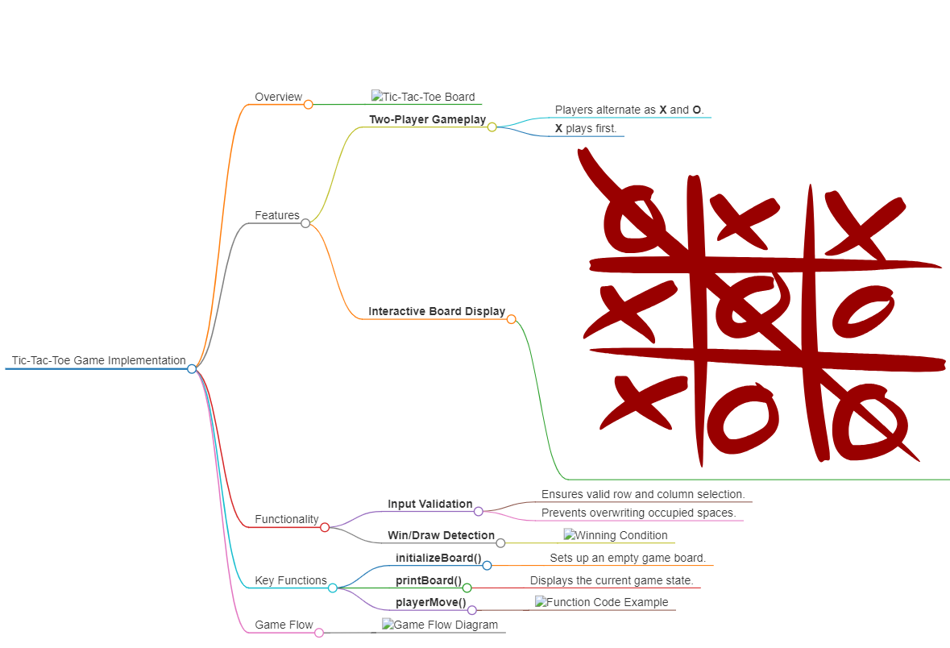
Lab 7 Home Work

